Slide 1
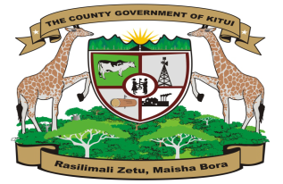
Urbanization Trends in Kitui County Economic Investment Zones (EIZs)
Enhancing Revenue Through Strategic Urban Development
COUNTY GOVERNMENT OF KITUI
MINISTRY OF LANDS, HOUSING AND URBAN DEVELOPMENT

Slide 2
Introduction
Economic Investment Zones (EIZs) have proven globally to be powerful engines for economic transformation. In Kitui County, these zones are strategically designed to spur growth through targeted investments, infrastructure development, and job creation. The success of Special Economic Zones worldwide – like Shenzhen's remarkable rise from a fishing village to a $400 billion economy – demonstrates their potential when properly implemented.
Kitui's development blueprint, KIVEST 2025, establishes six strategic EIZs: Kyuso-Mumoni-Tseikuru, Mui Basin, Mwingi Town, Kitui Town, Kanyangi-Kanyonyoo, and Mutomo-Ikutha clusters. Each zone offers unique advantages, from mineral resources to transport corridors, forming an integrated framework for county-wide progress.
The critical link between EIZs and revenue generation is undeniable. Urbanization driven by these zones expands the tax base through business permits, property rates, and trade levies. As economic activity concentrates in these areas, property values rise and new revenue streams emerge. Nobel economist Paul Krugman's insight that "SEZs act as economic laboratories" perfectly captures their transformative potential.

Slide 3
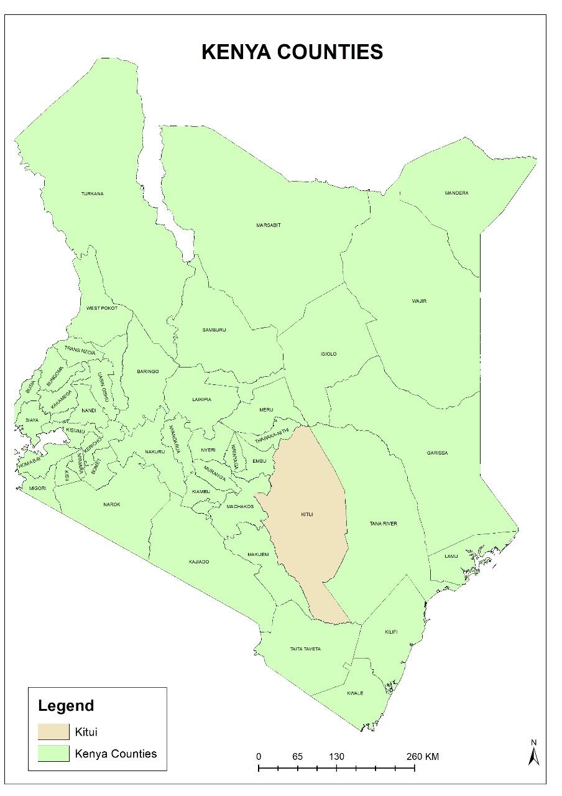
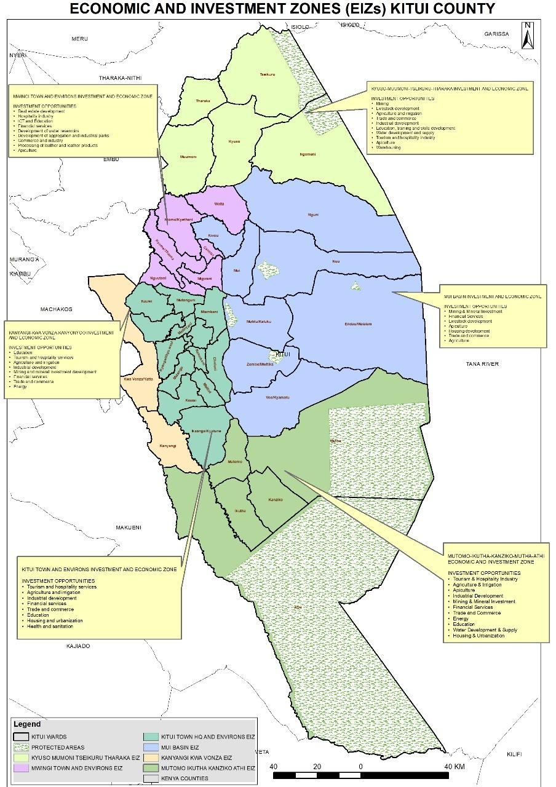
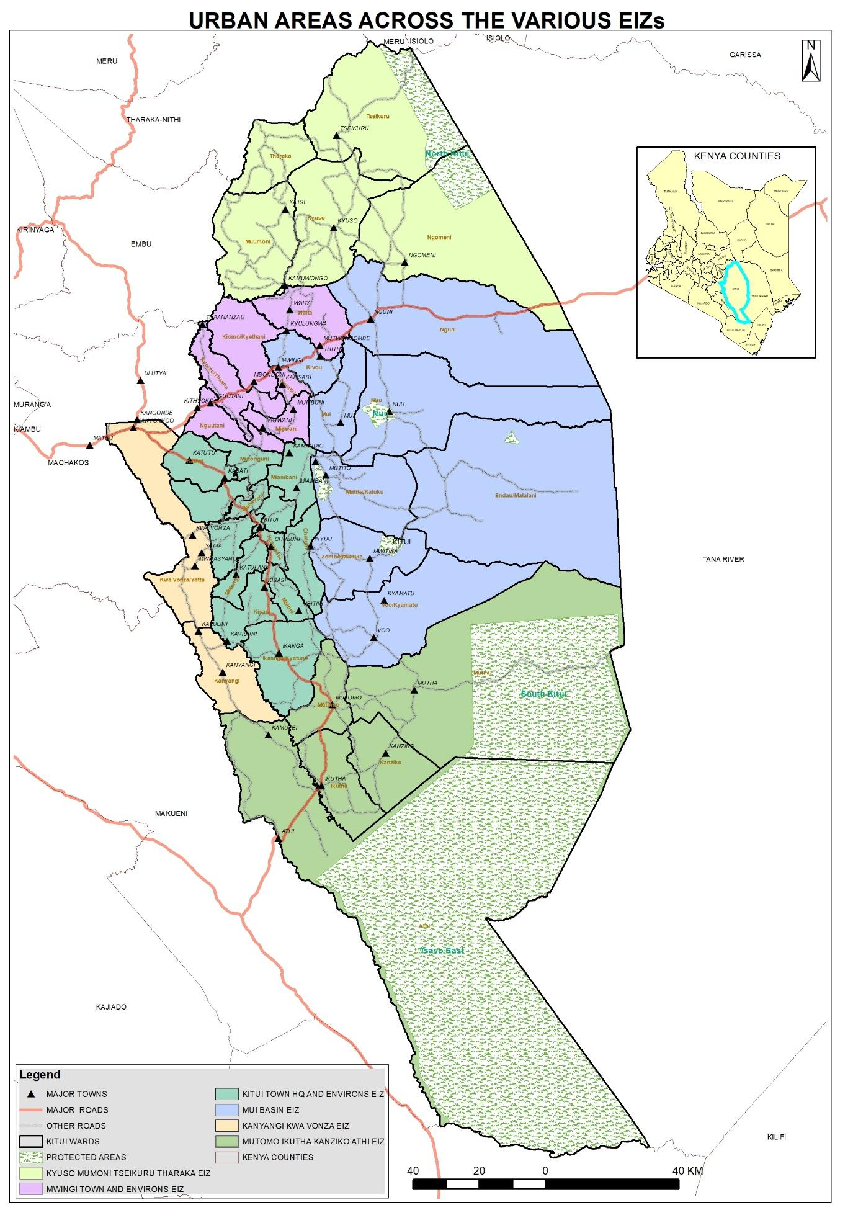
Kitui County Overview
Map 1: Kitui County at national context
Map 2: Kitui County Economic Investment Zones

Slide 4
6 EIZ Zones
Kitui Town & Environs
Mwingi Town & Environs
Kyuso-Mumoni-Tseikuru-Tharaka
Mui Basin
Mutomo-Ikutha-Kanziko-Athi
Kanyangi-Kanyonyoo

Slide 5
1. KITUI TOWN AND ENVIRONS EIZ URBANIZATION TRENDS
The major urban areas within the zone are; Kitui, Kabati, Mbitini, Kisasi, Ikanga, Katulani and Kavisuni. Development of this zone, reflects the broader trends of economic diversification and infrastructural advancement in Kitui County, underscoring the importance of strategic planning and community involvement in shaping the future of these urban centers.
The zone has two major markets namely; Kalundu and Kabati. The markets form the major trading points of the zone. The markets serve as central point for the exchange of farm produce and livestock, attracting traders from both within and outside Kitui County. The markets’ proximity to Kitui Headquarters enhances their accessibility, facilitating the movement of goods and services. The markets operate on designated days enhancing their role as a commercial hubs. Kalundu and Kabati markets exemplifies the dynamic interplay between commerce and urbanization.
The zone is also endowed with several financial institutions like; banks (KCB, Equity, ABSA, NCBA, National Bank e.t.c), Macro finances, Saccos (Univision DT Sacco, Universal DT Sacco) providing financial services to the residents within the zone and beyond. The financial institutions have facilitated greater financial inclusion for small and medium enterprises in the market.
Educational institutions within the zone play a pivotal role in shaping the region’s urbanization trajectory. These institutions not only enhance human capital but also stimulate economic activities, infrastructure development and social dynamics that contribute to the growth and transformation of the town.
The influx of urban residents within the zones creates demand for housing, retail services and transportation, hence leading to urban growth.

Slide 6
Key Strategies that can promote urbanization and revenue generation
Establishment of wholesale market for agricultural products to eliminate competition with retailers – this will make retail trade more vibrant even in the peri urban market centres within the zone and expand the tax bracket hence enhanced revenue and urban vibrancy
Improvement of the urban infrastructure including roads, abattoirs, dumpsites, markets and parking facilities to create order and efficiency for business people trading in the zone’s urban areas
Preparation of Physical Land Use Development Plans for the aforementioned urban centers. The plans will go long way in addressing security of tenure. Providing land owners within urban centers with authentic land ownership documents improves revenue through payment of land rates.
Provision of streetlights to enhance working hours for all cadres of traders
Provision farm produce storage facilities within the urban centers to reduce post-harvest losses and improve market access
Construction of modern livestock markets complete within the three major markets, Kisasi,Kalundu and Kabati for more controlled trading and minimum losses
KITUI TOWN AND ENVIRONS

Slide 7
2. MWINGI TOWN AND ENVIRONS EIZ URBANIZATION TRENDS
In this zone, the major urban areas include Mwingi, Migwani, Waita, Mbondoni, Nguutani among others.
Mwingi town is the largest town in the zone. The town’s location along Thika-Garissa highway places the zone strategically for business access to broader markets and supply chain fostering economic integration and development.
The proposed LAPSSET corridor is aimed to enhance connectivity, facilitating trade and movement of people and goods. The town has attracted private sector investors leading to the development of various commercial properties including residential units, shops and offices. This carters for growing demand from businesses and residents.
Migwani urban area is surrounded by fertile land supporting a thriving agricultural sector that sustains the local population and creates opportunities for agrobusiness ventures including processing and value addition. provides potential for tourism development owing to its the Ikoo valley. The valley’s scenic landscapes including the Kaluu view point with its panoramic views of the Ikoo river and surrounding hills provide opportunities for ecotourism activities such as hiking and photography. This attraction contributes to the regions appeal as a gate away from urban life. The construction of modern building including hotels and conference facilities reflects the towns evolving landscape and its increasing appeal to investors and visitors.
The Waita rock catchment serves as avital water source for local communities. Urbanization in nearby areas has led to increased tourism which is economically beneficial.
Kwa Machina gypsum factory (Erdemann Gypsum Limited) at Mtwangombe, is a key player in the local construction materials industry. The factory has attracted a workforce leading to the growth of Mutwangombe and Nguni. The Garissa highway facilitates movement of raw materials from Tana River County to the site and finished products to the market.

Slide 8
Key Strategies that can promote urbanization and revenue generation
Improvement of general urban infrastructure to make the environment conducive for more business vibrancy
Prepare and approve Local Physical and Land Use development Plans for all the towns within the zone to enable landowners access ownershop documents hence increased land rates collection and investments
Construction of a modern abbatoir in Mwingi Town to tap on the livestock markets in Nguni,Ukasi,Ngomeni and Tseikuru hence increased market
MWINGI TOWN AND ENVIRONS

Slide 9
3. KYUSO-MUMONI-TSEIKURU-THARAKA EIZ URBANIZATION TRENDS
Situated in northern Kitui County, the Kyuso-Mumoni-Tseikuru-Tharaka EIZ represents a region of immense strategic and economic importance. Anchored by urban centers such as Tseikuru, Kyuso, Kamuwongo, and Ngomeni, this zone benefits from its proximity to the LAPSSET corridor, positioning it as a critical gateway for regional trade and investment. The Tana River further enhances the zone's potential by providing a reliable water source for agriculture and industrial activities, transforming previously arid areas into productive hubs.
Tseikuru serves as a vital economic node, particularly for livestock trade, connecting pastoralists and farmers across the region. The market's vibrant exchange of goats, sheep, cattle, and poultry stimulates local commerce and supports livelihoods. Additionally, the zone is rich in mineral resources, including limestone deposits in Ngaaie, which have attracted major cement manufacturers like Athi River Mining (ARM). Iron ore in Mataka and copper gemstones in Kimo further highlight the area's untapped mining potential, offering opportunities for industrial growth and job creation.
Agriculture thrives through irrigation projects such as the Wikithuki scheme, which supports year-round farming on up to 10,000 acres, boosting food security and rural incomes. Meanwhile, tourism presents another key economic pillar, with attractions like the Mwingi North Game Reserve, Kora National Park, and the Mumoni Hills Forest Reserve—a premier birdwatching destination. These sites draw visitors, spurring infrastructure development and service-sector growth.
The convergence of trade, mining, agriculture, and tourism in this zone creates a dynamic urbanization pathway. Strategic investments in infrastructure, sustainable mining practices, and eco-tourism will be essential to harness its full potential while ensuring inclusive and environmentally responsible growth.

Slide 10
Key Strategies that can promote urbanization and revenue generation
Operationalization of the Kitui County tourism circuit to take advantage of the Mwingi North game reserve and the Kora National Park. This will increase business vibrancy in the adjacent urban areas and possibly lead to an increase in investments hence more revenue collection
Provision of the necessary facilities such as loading ramps, water troughs, fences, sheds, pay points and lavatories in all livestock yards within the urban centres to boost livestock trade hence increased revenue collection
Register and license artisanal miners in the zone to legalize their operations and improve regulation, safety, and taxation. Introduce “mining-for-greening” projects: every mining license must contribute to a fund for environmental conservation hence create more jobs.
KYUSO-MUMONI-TSEIKURU-THARAKA

Slide 11
4. MUI BASIN EIZ URBANIZATION TRENDS
This economic zone cuts across Mui, Zombe, Mwitika, Mutitu,Kaliku, Endau,Malalani, Nguni and Voo, Kyamatu urban areas of Mwingi Central and Kitui East Sub Counties. The main potential this zone is the coal mining and associated coal power generation and industry. Strategic investments in mining, financial services, livestock development, apiculture, housing, trade, and agriculture have the potential to transform the region's economy, improve livelihoods, and position Kitui County as a key player in Kenya's development agenda. Beyond coal, the Mui Basin also contains deposits of limestone, iron ore, graphite, copper and manganese, offering diverse opportunities for mineral extraction and process.
There is also a lot of livestock trade with the major markets in the zone being Nuu, Nguni and Zombe
Nguni is strategically located along key transport route making it a crucial hub for trade services and investments. The presence of external vendors offering a variety of goods further enriches the markets diversity and appeal.
Zombe serves as a vital trading centre facilitating the exchange of agricultural produce, livestock and household goods. By harnessing available water resources effectively farmers along the Thua river in Zombe, Inyuu, Voo is overcoming climatic challenges leading to increased agricultural productivity and improved community resilience. AMREF health Africa, Kitui WASH project has worked to improve water access and sanitation in the area through thr development of water harvesting systems and the promotion of sustainable agriculture, hence enhancing the quality of life for residents.
Nuu hills stands out with 13 springs forming a great water catchment area in the zone. Mutitu hill is home to different species of birds, a diversity of fauna and flora making it a haven for nature enthusiasts. Nzau dam constructed in the 1930s provides water to the mutitu urban areas residents

Slide 12
Key Strategies that can promote urbanization and revenue generation
Explore the possibility of safe and sustainable coal exploration to boost economic activities in the area.
Develop abattoirs and meat processing facilities in major urban centres within the zone to add value to livestock products, create employment and boost the local economy.
Establish honey processing plants, cooperative hubs, and packaging industries. Create platforms for beekeepers to access wider markets, ensuring fair trade and sustainable income.
Consider provision of land ownership documents to areas that are not adjudicated especially in Nuu area. This will enable residents access credit more easily hence increased investments and business expansion leading to more revenue
MUI BASIN

Slide 13
5. MUTOMO-IKUTHA-KANZIKO-ATHI EIZ URBANIZATION TRENDS
The location of this zone along Kitui-Kibwezi road, which a major transport corridor improved connectivity reducing travel times and facilitating the movement of goods and people thereby stimulating economic activities and urban growth. This road has been a catalyst for urbanization in Mutomo, Ikutha, Athi markets driving economic growth, improving infrastructure and enhancing the quality of life for residents.
The Mutomo reptile park aims to promote biodiversity conservation and act as a tourist attraction site. The park focuses on snake species and venom extraction contributing to both research and tourism development. The Kitui county government in collaboration with the national council of churches of Kenya established the Mutomo botanical garden, which seeks to enhance ecological sustainability.
Schools, college and technical institutions attracts students, staff and investors leading to urban experience . Education hubs create demand for housing transport, food services and recreational facilities fostering a knowledge driven urban economy
Mutha market is renowned for its vibrant livestock trade particularly goats. This trade attracts traders from various regions across the country contributing to the market’s economic dynamism. The regular livestock auctions and trade events foster a bustling commercial environment promoting local entrepreneurship and trade.
Tsavo east national park offers immense tourism potential that significantly contributes to regional urbanization and economic development. The park is known for its reach biodiversity, unique landscapes and accessibility making it a prime destination for ecotourism and conservation efforts. Increased tourists numbers stimulate local businesses including crafts, food services and transport.

Slide 14
Key Strategies that can promote urbanization and revenue generation
Provide necessary facilities such as loading ramps, water troughs, fences, sheds, pay points and lavatories in all livestock yards within the urban centres.This is likely to boost livestock trade especially in the Mutha area where it is vibrant hence increased revenue collection
Operationalization of the tourism circuit to take advantage of the neighbouring National Park and the Game Reserve. This is likely to boost urbanization and revenue in both Ikutha and Mutomo urban centers
Partnership with private investors to build eco-lodges, resorts, and cultural villages in scenic and historical areas within the zone.
Improvement of security on the Kitui – Tana River border to boost stability hence attract more investments
MUTOMO-IKUTHA-KANZIKO-ATHI

Slide 15
6. KANYANGI KANYONYOO EIZ URBANIZATION TRENDS
Kanyonyoo strategic location at the convergence of major roads, Thika-Garissa, Kitui-Kibwezi and Embu-Siakago enhances its accessibility and connectivity to other parts of the nation. Establishment of the Kitui County Aggregation and Industrial Park(K-CAIP) is essential development in the region. This facility is designed to serve a centralized hub for value addition and marketing of Kitui agricultural products. The Park enhances market access and creates opportunities for local producers and investors.
Large quantities of construction rocks sufficient to support ballast crushing plants – the establishment of the rock crasher at Kwa Kilui. This provides material for road construction both locally and across the county.
Moreover, the zone has a great potential in agriculture, livestock farming, horticulture owing to its proximity the proposed Thwake dam. Mwitasyano and Tiva rivers although are seasonal rivers can provide water for irrigation through the sinking of sump wells.
Additionally, there are iron ore minerals deposits in Mithikwani and Mikuyuni areas. Artisanal miners get their daily livelihoods from small scale mining.
As an education hub, Kwa vonza is home to two major universities i.e. South Eastern Kenya University (SEKU) and Kenyatta University (KU). Today, 20 000 of Kwa Vonza’s residents are students and staff from the two universities. Kwa Vonza town provides accommodation for the numerous students, provide market for goods and services in the market. Local residents work in the university to improve livelihoods.

Slide 16
Key Strategies that can promote urbanization and revenue generation
Expand/improve infrastructure around learning institutions, including roads, hostels, and ICT facilities.
Establish irrigation schemes using local rivers and promote water harvesting technologies.
Completion and successful operationalization of the County Aggregation and Industrial Park at Kanyonyoo.
Expansion and modernization of open-air markets in Kanyangi, Kanyonyoo and Kwa Vonza.
Register and license artisanal miners to legalize their operations and improve regulation, safety, and taxation. Introduce “mining-for-greening” projects: every mining license must contribute to a fund for tree planting and conservation.
KANYANGI KANYONYOO

Slide 17
Conclusion
Urbanization serves as a powerful driver of own-source revenue growth in Kitui County, creating a direct link between planned urban development and enhanced fiscal capacity. To maximize this potential, the county must strategically harness the unique advantages of each Economic Investment Zone (EIZ) through targeted interventions.
Key priorities include:
Development of a County Spatial Plan – This will formally zone land uses across the county, expanding rateable areas under the National Rating Act (2024) and increasing revenue from land rates. Proper spatial planning ensures orderly urbanization while optimizing revenue streams.
Full Implementation of KIVEST – The county must operationalize this vision through clear policies and institutional frameworks. Extending KIVEST beyond 2025 and aligning it with the spatial plan will ensure long-term sustainability, guiding investments in infrastructure, trade, and industrialization.
By adopting these measures, Kitui County can accelerate urbanization in a structured manner, unlocking new revenue opportunities while fostering equitable development across all zones. The success of this approach hinges on collaboration between county agencies, national government, private investors, and local communities to build a more prosperous and self-reliant future.

